Slide 1
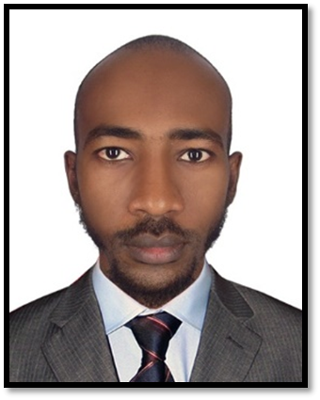
Physiology of the
cardiovascular system
Lecture (1)
Prepared and presented by: Dr. Mazin Salaheldin Abdalla
MBBS
MD (cardiology)
M.Sc. Human physiology
M.Sc. Molecular medicine
Illustrations from (Lippincott illustrated medical physiology)

Slide 2
Road-Map…
Introduction to CVS, functional anatomy and basic physiology
Cardiac cycle: the whole story
EKGs: (Electrocardiography, electrocardiogram and electrocardiograph)
Bridge to clinical cardiology
Equations in a nutshell

Slide 3
Aims of the mini-lectures…
Familiarize the students with the CVS physiology
Reduce the gap between basic and clinical CVS physiology
Make the argument for the easiness and fun of CVS physiology

Slide 4
Function of the CVS…
The primary function of the heart is to pump blood
The function of the vascular system is to circulate blood throughout the body to deliver nutrients to the tissues and collect the waste products

Slide 5
Functional anatomy…
The primary function of the heart is to insure that blood is being moved in circle around the body
It is made up of muscle called (cardiac muscle)
Like any other hollow organ, it has three layers
(inner, middle, outer)-(Endocardium, myocardium and Epicardium)

Slide 6
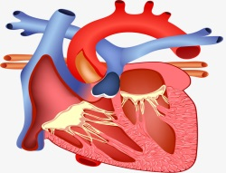
Inferior v. cava
Right atrium
Superior v. cava
Tricuspid valve
Right ventricle
Pulmonic valve
Pulmonary trunk
Right and left pulmonary arteries
Pulmonary veins
Left atrium
Mitral valve
Left ventricle
Aortic valve
Aorta
Systemic circulation

Slide 7


Pulmonic circulation
Right atrium
Left atrium
System circulation

Slide 8
The heart is an excitable tissue…
The body contains 4 types tissues (epithelium, connective, muscles and nervous)
Only 2 are considered excitable (muscle and nervous)
They are called excitable because they can generate action potential and they can do so because they possess voltage gated sodium channel

Slide 9
Cardiac muscle….
Contractile cardiac muscle
(Contraction)
Conductive cardiac muscle
(Generation and conduction of action potential)

Slide 10
Cardiac properties
Inotropy
Dromotropy
Chronotropy
Lusitropy
Bathmotropy
Automaticity
To generate electrical impulses
Excitability
To respond to electrical impulses
Conductivity
To allow the transmission of impulses
Contractility
To contract after excitation
Rhythmicity
Impulses sent in evenly manner
Refractoriness
Inability to respond to another stimulus

Slide 11
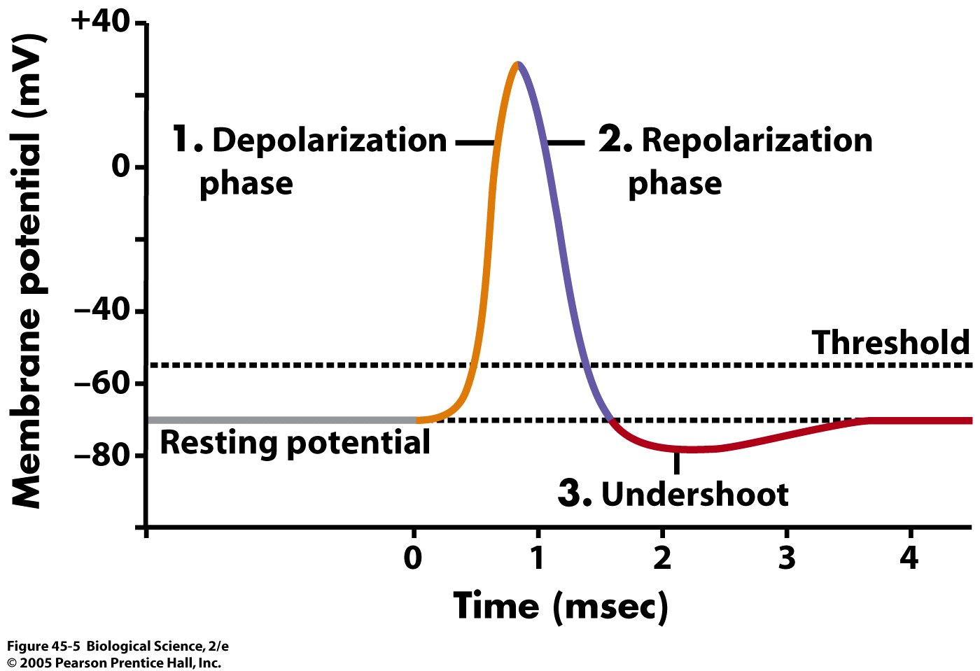
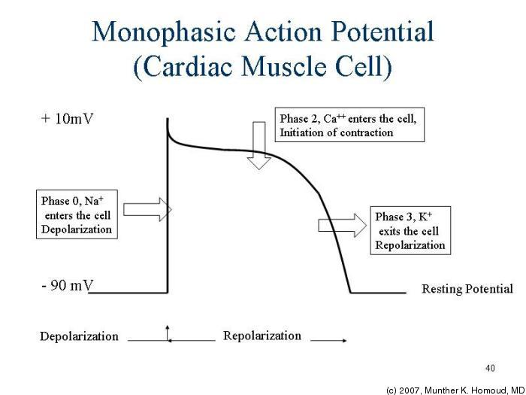
Cardiac action potential…
Skeletal muscle action potential
Cardiac muscle action potential

Slide 12
Looking ahead: What is it all about? The duality of terms
Resistance
Systole
Contraction
Inotropy
Right heart
Oxygenated
Heart induced
Volume
Diastole
Relaxation
Lusitropy
Left heart
Deoxygenated
Vascular induced

Slide 13
Physiology lit. (recommended)…
Guyton and Hall textbook of physiology
Lippincott illustrated physiology
Ganong review of medical physiology
Linda Costanzo textbook of medical physiology
BRS, Linda Costanzo
Essential to physiology

